Slide 1

USA PERFORMANCE®
Manage Performance, Ensure Success
OPM’s Performance Management System for Federal Agencies
Organization Features Requirements Meeting
December 12th, 2018
OFFICIAL USE NOTICE: This material is intended exclusively for use by USA Performance Customers and is not to be distributed without approval from the USA Performance Program Office. This communication may contain information that is proprietary, privileged, confidential or otherwise legally exempt from disclosure. If you have received this presentation in error, please notify the USA Performance Program Office immediately and delete all copies of the material.

Slide 2
Agenda
Introductions
Roadmap for FY19
Overview of Current Org and Admin Features
Review Proposed Org Feature Requirements
Discuss Org Features
Review Proposed Admin Feature Requirements
Discuss Admin Features
Closeout

Slide 3

Introductions
Name
Component
Role with USA Performance

Slide 4
Major FY 19 Development Items
Web Service and eOPF Interconnection
Grouping Elements for Weighting
SES Pay Plan Updates
Additional Features for FY19
Ongoing Research Items for FY19
Organizational Structure and Users Roles & Permissions

Slide 5




Major FY 2019 Development Items
Planned development and releases cross multiple components of the system. Major development goals include data exchanges to receive personnel data and submit performance data, major revisions and updates to organizational structure and user roles and permissions, new reports, and continued updates to the dashboard.
Data Exchanges
User Interface
SES Plan Functionality
Non SES Plan Functionality
Permissions & Structure
Web Services
Dashboard Items
Pay Plan Updates
Group Elements for Weighting
Org Structures
eOPF
PIV Logins
PRB Features
Plan Audit
User Roles
System Timeouts
Plan Audit
Reports
User Permissions
Special Characters
Reports
Proxy Permissions
Characters Limits
Resource Center

Slide 6
FY 2019 Development Timeline <Estimated>
Data Exchanges
User Interface
SES Plan Functionality
Non SES Plan Functionality
Permissions & Structure
Quarter 1
Quarter 2
Quarter 3
Quarter 4
Dashboard Items
Proxy Permissions
Web Services
Org Structures
System Timeouts
Org Structures
Dashboard Items
User Permissions
PRB Features
eOPF
User Permissions
Special Characters
User Roles
Resource Center
Reports
Pay Plan Updates
Special Characters
Elements Weights
Characters Limits
User Permissions
Org Structures
Reports
User Roles
PIV Logins
Elements Weights
User Roles
Plan Audit
Development
Releases
Dashboard Items
Release 15
(Nov 8)
Web Services
Release 17
(Mar 31)
PIV Logins
Release 18
(May)
Org Structures
Release 19
(July)
PRB Features
eOPF
Elements Weights
User Permissions
Pay Plan Updates
Release 16
(Dec 6)
User Roles
Release 20
(Sept)
Proxy Permissions
Web Services

Slide 7
FY19 Quarter 1
Month | Data Exchange | User Interface | SES Plan Functionality | Non SES Plan Functionality | Permissions and Structure
October | Start initial technical discussions for a Web Service interconnection | Develop Dashboard enhancements | Update the PRB wording conventions |  | Develop enhancements to allow end users to add System Admins as proxies
November Program Office Quarterly Planning Meeting | Begin work on Non-SES eOPF interconnection Continue technical discussion for a Web Service interconnection |  | Develop updates to accommodate EV/FJ pay plans with SES functionality November 8th Release PRB features
December | Begin developing a Web Service interconnection |  | December 6th Release EV/FJ pay plan |  | December 6th Release System Admin proxy feature Gather Org Structure Requirements

Slide 8
FY19 Quarter 2
Month | Data Exchange | User Interface | SES Plan Functionality | Non SES Plan Functionality | Permissions and Structure
January |  | Investigate time out issues for end users Investigate streamlining the PIV registration process |  |  | Continue gathering and refining org structure and user & roles and permissions requirements Begin work on org structure enhancements
February Program Office Quarterly Planning Meeting | Finish work on the Web Service Test Web Service interconnection with DHS Finalize Non-SES eOPF interconnection |  |  |  | Continue work on org structure and user roles & permissions features
March | March Release Web Service Non-SES eOPF interconnections | Investigate special character issues |  |  | Demonstrate org structure and user roles & permissions features to stakeholders

Slide 9
FY19 Quarter 3
Month | Data Exchange | User Interface | SES Plan Functionality | Non SES Plan Functionality | Permissions and Structure
April |  |  |  | Develop feature to accommodate grouped elements for weighting | Conduct stakeholder testing of org structure and user roles & permissions features
May Program Office Quarterly Planning Meeting |  | Develop features to reduce special character limitations May Release PIV and time out solutions may be included |  | May Release Grouped element features | Continue work on org structure and user role & permissions features
June | Initiate technical discussions for adding organization to the Web Service interconnection | Finalize solution for the special character issue |  |  | Finalize the org structure and user roles & permissions features for regression testing

Slide 10
FY19 Quarter 4
Month | Data Exchange | User Interface | SES Plan Functionality | Non SES Plan Functionality | Permissions and Structure
July | Develop organization Web Service interconnection |  |  | Develop audit features for Part 1 of performance plans Review USA Performance reports requirements with stakeholders | July Release Org structure and user role & permissions features
August* Program Office Quarterly Planning Meeting |  | Investigate Resource Center alternatives |  | Develop updated reports features Demonstrate and test reports features with stakeholders
September | September Release Web Service update may be included | Develop updates to performance plan user interface Develop updates to a Resource Center | September Release Reports and audit features | September Release Reports and audit features
*Meet with stakeholders to determine development priorities for FY20

Slide 11
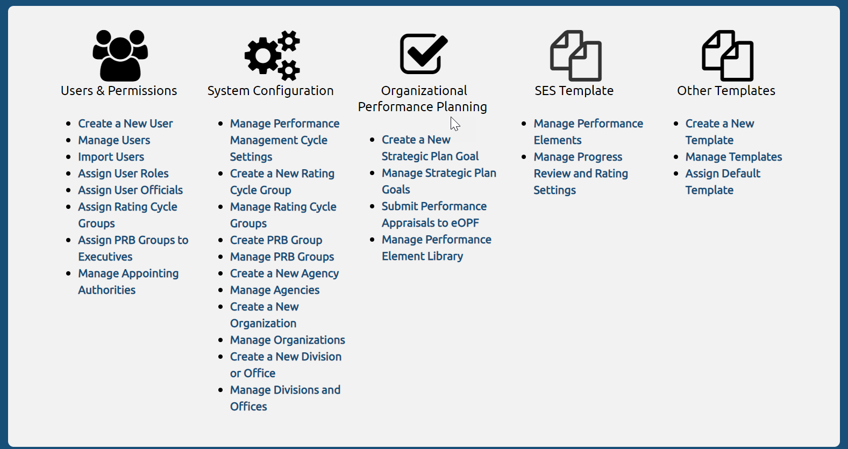
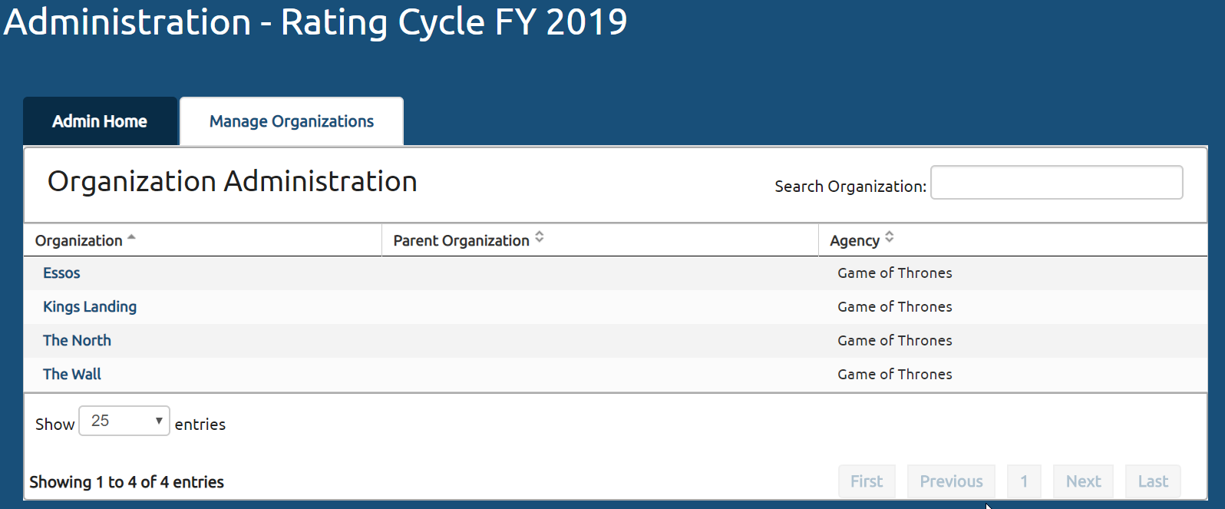
Overview of Current Org and Admin Features

Slide 12
Proposed Org Feature Enhancements
Eliminate Sub-Agencies, Sub-Organizations, and Divisions
Allow Agencies to Name Units
Update User Interface
Link New Org Features to USA Performance Interconnection

Slide 13
Tier One Unit
Tier Two Unit
Tier Two Unit
Tier Two Unit
Tier Two Unit
Tier Three Unit
Tier Three Unit
Tier “X” Unit
Tier “X” Unit
Tier Three Unit
Tier Three Unit
Tier “X” Unit
Tier Four Unit
Tier Four Unit
Tier Four Unit
Tier Four Unit
Tier “X” Unit
Tier Five Unit
Tier Five Unit
Tier Five Unit
Tier “X” Unit
Tier Five Unit
Tier Five Unit
Tier “X” Unit
Tier “X” Unit
Tier Six Unit
Tier Six Unit
Tier Six Unit
Tier Six Unit
Tier “X” Unit
Tier “X” Unit
Tier “X” Unit
Tier “X” Unit
Tier “X” Unit
Notes:
Add photo

Slide 14
DHS
USCIS
TSA
CISA
DHS HQ
Office of Policy & Strategy
Executive Secretariat
Tier “X” Unit
Tier “X” Unit
A&O - OPS COORD
OCRSO
Tier “X” Unit
Office of Administration
Office of CIO
OFC OF OP COORD
OPS FRONT OFFICE
Tier “X” Unit
Facilities Mgmt Division
Mail Mgmt Division
Front Office
Tier “X” Unit
MISSION SUPPORT
CONTINUITY DIV
Tier “X” Unit
Tier “X” Unit
Applied Technology
Information Security
ACQUISITION
BUDGET
Tier “X” Unit
Tier “X” Unit
Tier “X” Unit
Tier “X” Unit
Tier “X” Unit
Notes:
Add photo

Slide 15
DHS HQ Agency Admin View
DHS HQ
A&O - OPS COORD
OCRSO
OFC OF OP COORD
OPS FRONT OFFICE
Tier “X” Unit
Tier “X” Unit
MISSION SUPPORT
CONTINUITY DIV
ACQUISITION
BUDGET
Tier “X” Unit
Tier “X” Unit
Tier “X” Unit

Slide 16
Discussion of Proposed Org Features
Will these proposed org features work for you?
What do you think we should do differently?
What would make this better?
Are there other ways you’d like to see organizations represented in USA Performance?
What data should be tracked with organizations?
How should org updates impact end users?

Slide 17
Proposed Admin Features
Admins can delegate appropriate admin capabilities to subordinate units
Features will be broken into appropriate segments
Admins can be assigned to multiple units
Admins can work within the parameters established for each unit

Slide 18

Proposed Admin Features – Cont’d
Basic Unit Functionality
Manage Non-SES Templates
Create Non-SES Templates
Users & Permissions
Rating Cycles
Organizational Structure
Strategic Goal Library
Performance Element Library
PRB Group Assignments
SES Template
Additional SES Templates

Slide 19

Basic Unit Level Admin Permissions
Create and Manage Users
Assign User Roles
Assign User Officials
Assign Default Templates

Slide 20

Users & Permissions
Assign Rating Cycle Groups
Import Users

Slide 21
Rating Cycles
Create a New Rating Cycle Group
Manage Rating Cycle Groups

Slide 22

Organizational Structure
Create and Manage Organizational Units

Slide 23

Strategic Goal Library
Create and Manage Strategic Plan Goals

Slide 24

Performance Element Library
Manage Elements from the Performance Element Library

Slide 25

Performance Review Board (PRB) Group Assignment
Assign PRB Groups to Executives

Slide 26

SES Template
Manage SES Performance Elements
Manage SES Progress Review and Rating Settings

Slide 27

Additional SES Template
Manage SES Performance Management Cycle Settings
Create/Manage PRB Groups

Slide 28

Manage Non-SES Templates
Manage Non-SES Templates

Slide 29
DHS HQ Agency Admin Features
DHS HQ
A&O - OPS COORD
OCRSO
OFC OF OP COORD
OPS FRONT OFFICE
MISSION SUPPORT
CONTINUITY DIV
ACQUISITION
BUDGET

Slide 30
DHS HQ Admin Access
DHS HQ
A&O - OPS COORD
OCRSO
OFC OF OP COORD
OPS FRONT OFFICE
MISSION SUPPORT
CONTINUITY DIV
Admin User
ACQUISITION
BUDGET

Slide 31
Discussion of Proposed Admin Features!
What do you think of the proposed admin features?
What could make these better?
What other admin features should we include?
Are there better ways to manage how admin rights are assigned?

Slide 32
Closeout – What’s Next?
We will refine the discussion today into specific requirements for our development team
We will begin designing these features for USA Performance
We will continue to engage DHS in the process

Slide 33

Jessica Wong
Account Manager
Jessica.Wong@opm.gov
(202) 815-1481
Ryan V. Hendricks, PMP
USA Performance Team Lead
Ryan.Hendricks@opm.gov
(202) 422-3066

